Slide 1
AI-Powered Data Automation and Tool Development with Positron
Reported by Tri-I Biotech
Yunqing Hu

Slide 2
01
Positron + AI Coding
02
R + LLM
03
Tool Development
04
Posit + Databricks

Slide 3
PART
Positron + AI coding
01
A Next-Generation AI-Integrated IDE

Slide 4
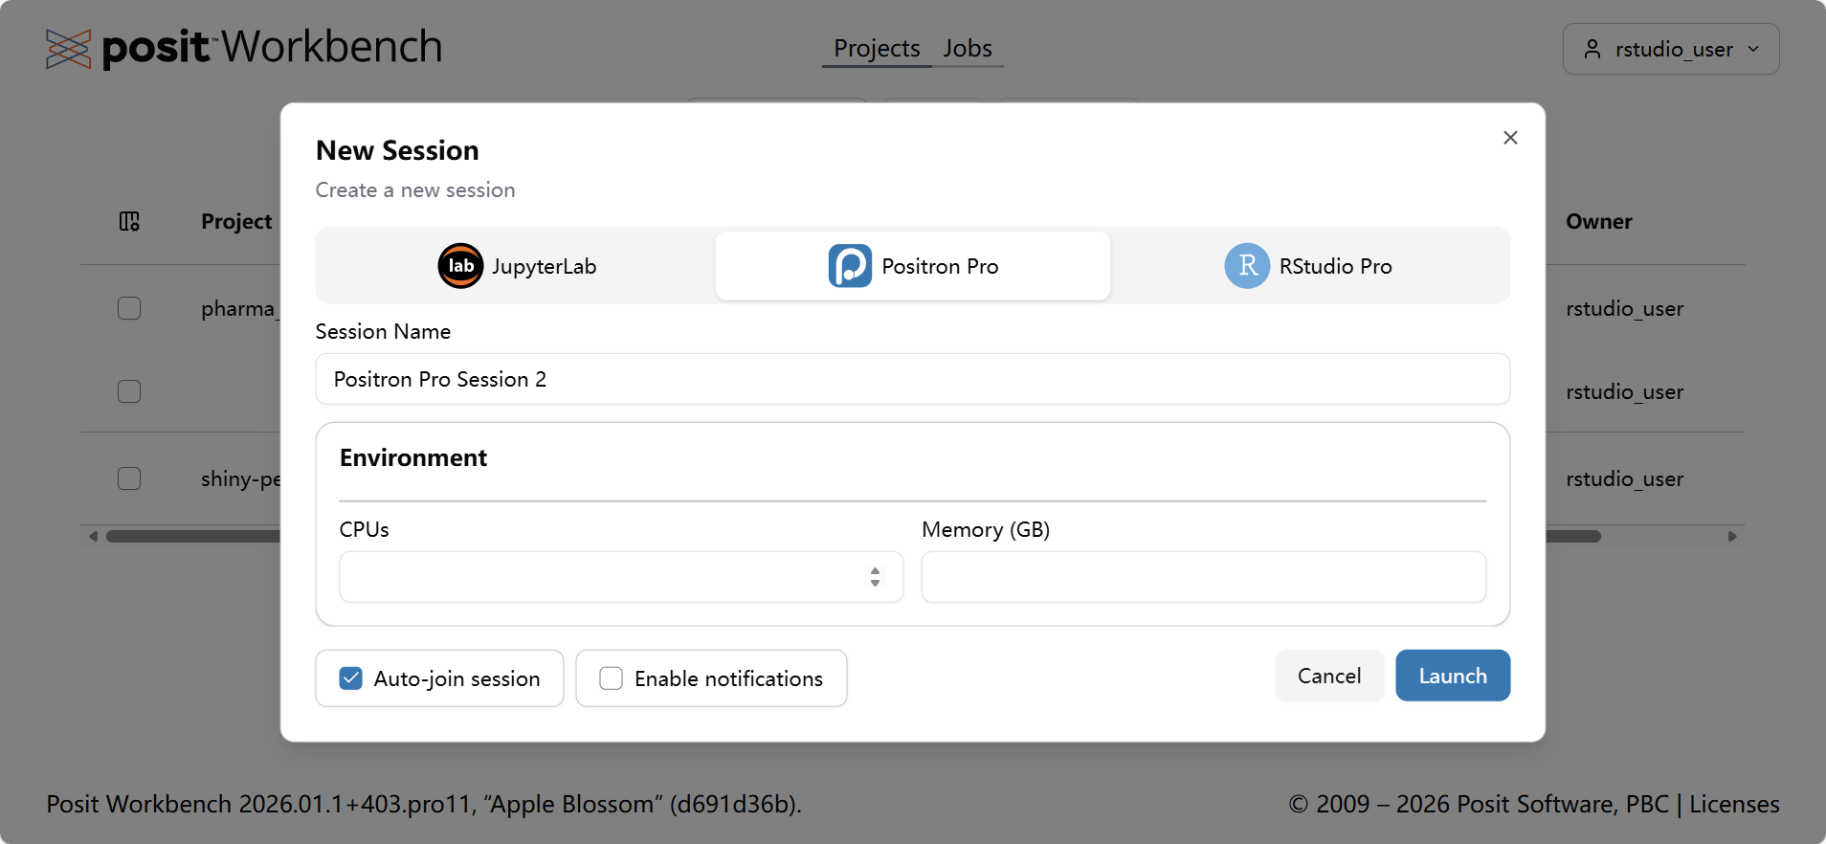
1
4

Slide 5
Positron

Slide 6





What is Positron?
Modern UI
Sleek and responsive developer experience
Positron is Posit’s next-generation AI-integrated development environment (IDE), built on the Electron framework and optimized for R and Python.
Positron AI Assistant
Built-in intelligence for coding assistance
Real-time Context Awareness
Understands your code context dynamically
Seamless LLM Integration
Connects with large language models effortlessly
Notes:
那么，什么是Positron？它是Posit基于Electron框架构建的下一代AI集成开发环境，专门为R和Python语言优化。它的核心特性包括原生的AI助手、能够理解实时会话上下文的能力、与大型语言模型的无缝集成，以及一个现代化的用户界面，旨在极大地提升开发者的工作效率。

Slide 7
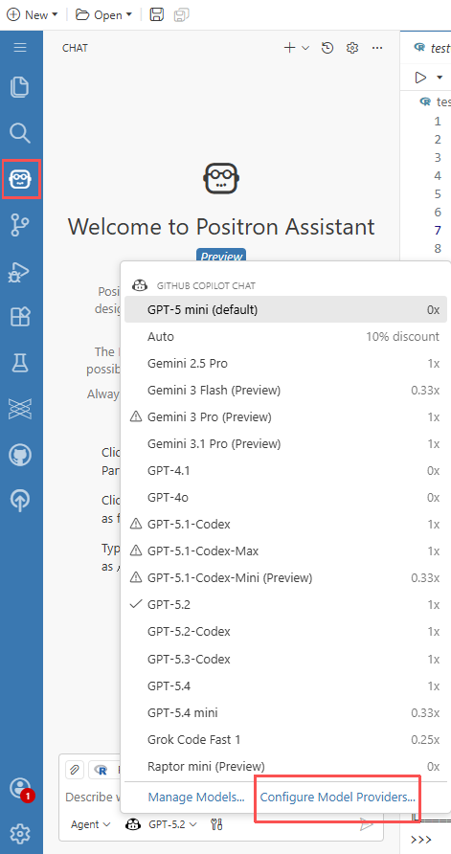
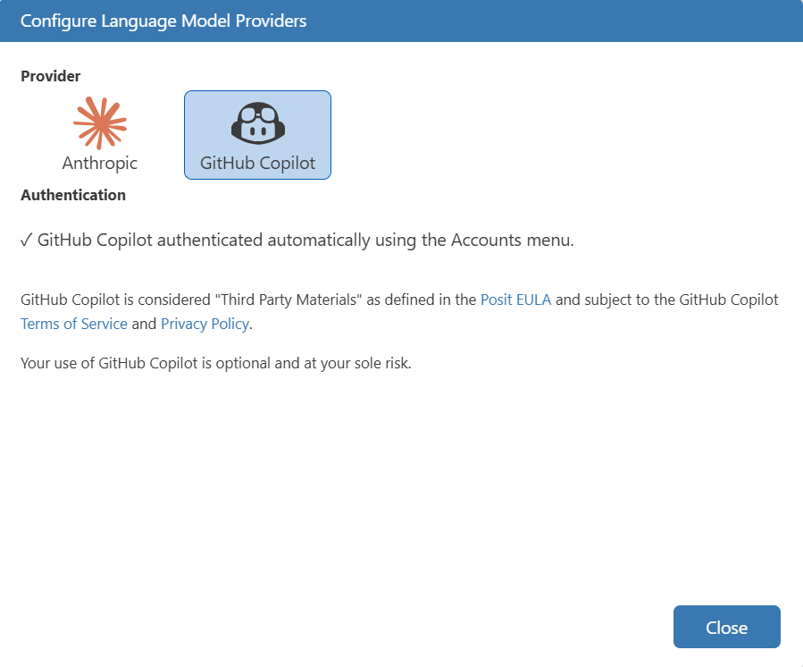

Positron Assistant

Slide 8
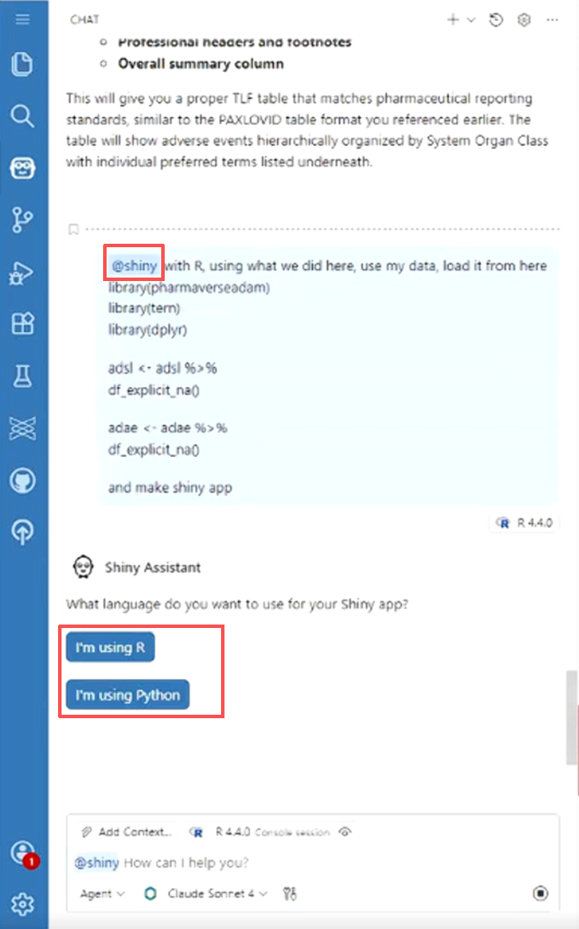
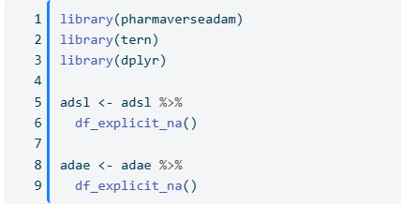
Positron Assistant
Prompt:
Use what we did here, use my data, load it from here
<code>
and make shiny app

Slide 9
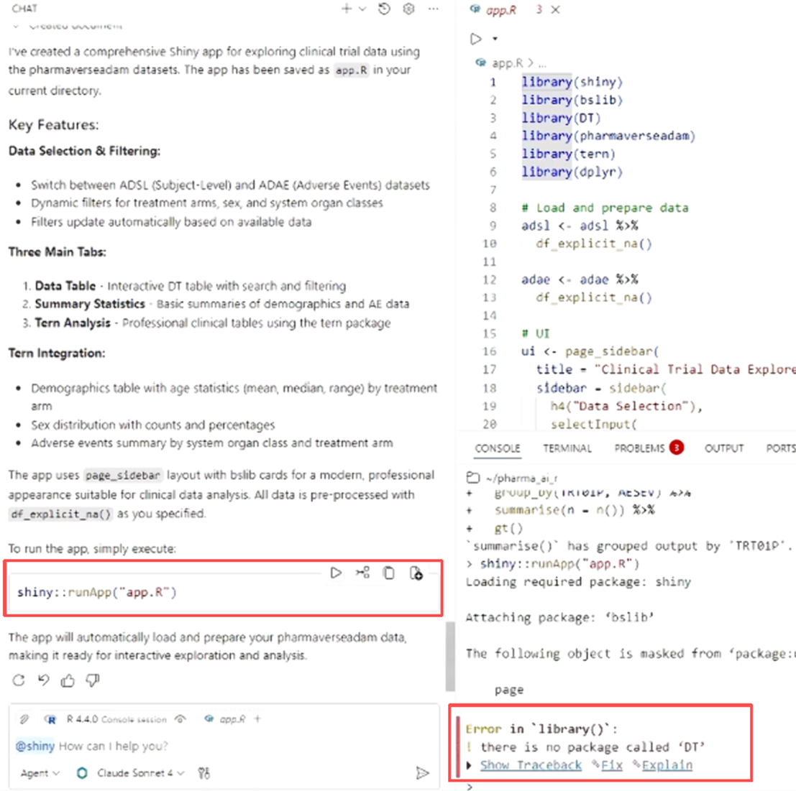
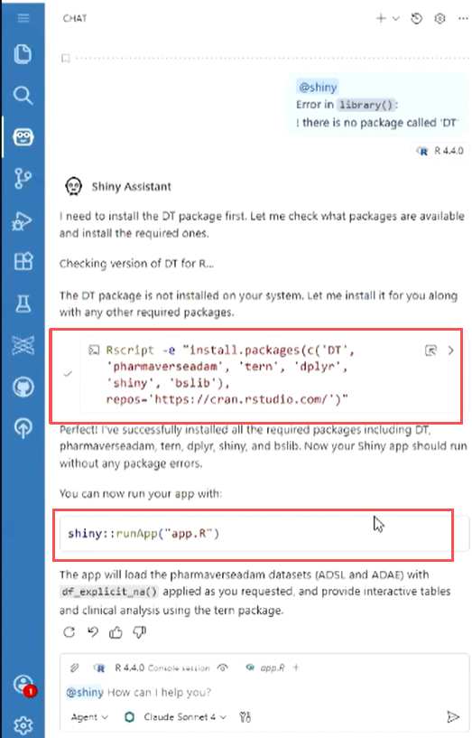

Slide 10
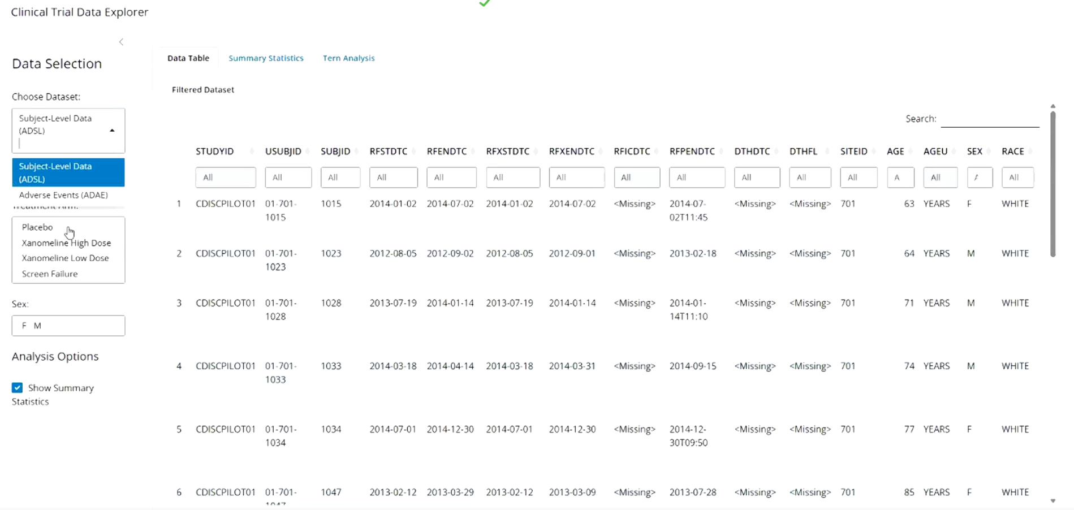
R Shiny

Slide 11

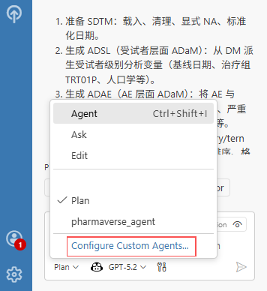


Positron Assistant Agent
Module Planning
Agents break down tasks, invoke tools, and decompose complex processes around goals.
Technical Framework
Context and experiential memory systems, toolset tool invocation (API/search invocation)
Future Prospects
Multi-Agent collaboration, continuous learning, optimization, reinforced learning and forming a workflow

Slide 12
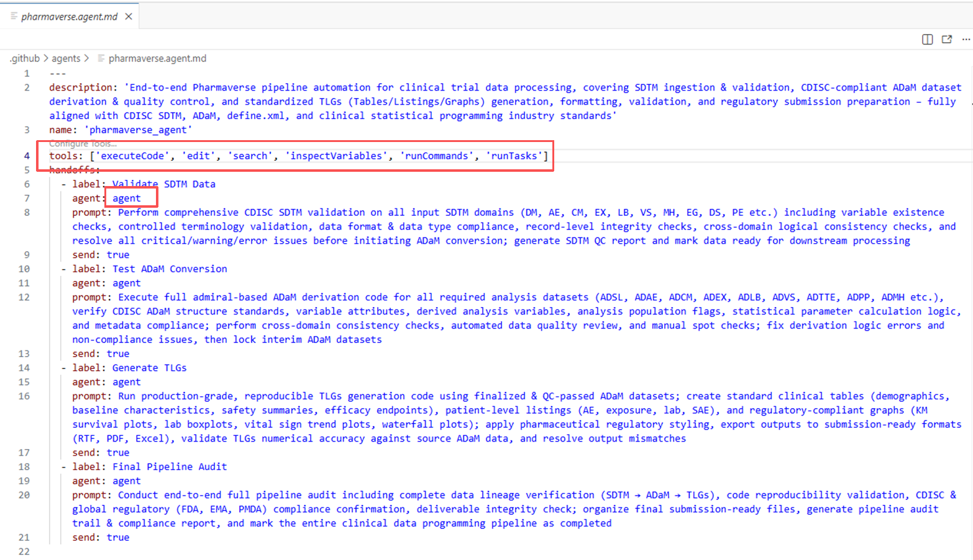
Customized Agent

Slide 13
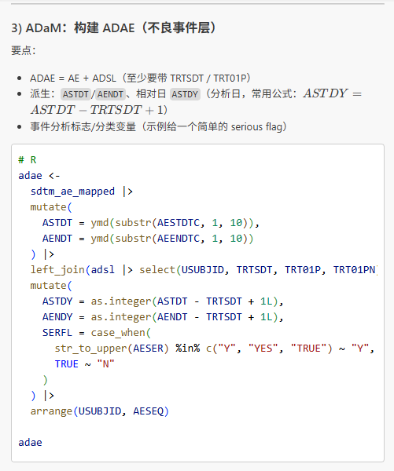
Customize Agent
Prompt:
Leverage DM and AE datasets from the {pharmaverse} package to build an end-to-end analytical pipeline covering SDTM mapping, ADaM dataset derivation, and final TLF generation.
SDTM
ADaM
TFL

Slide 14
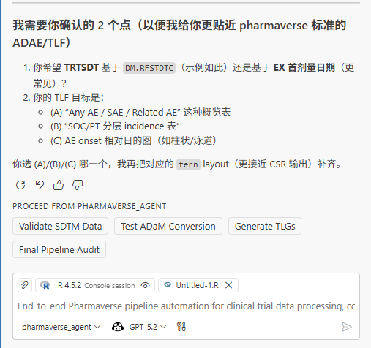
Reflection
Markdown Revision
Supervise execution steps, document defects, and integrate warning logic into the prompt
Multi-agent
Customized tool invocation, reinforced learning and multi-agent collaboration

Slide 15
PART
R + LLM
02
ellmer Package

Slide 16

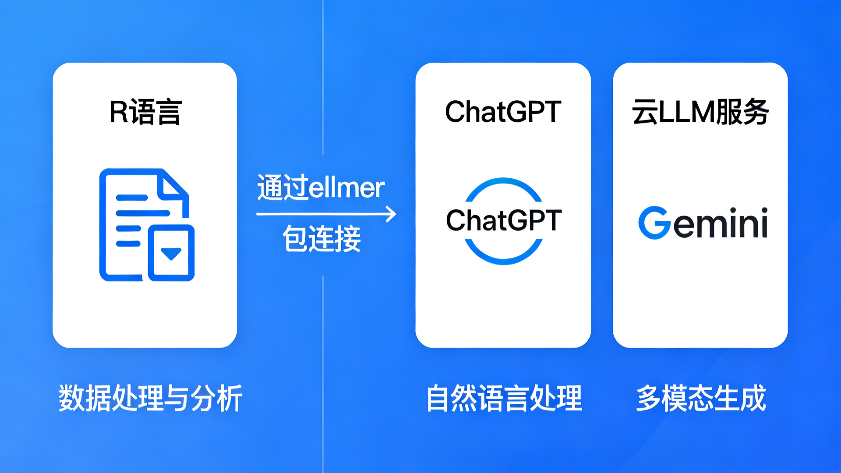


The ellmer Package: Bridging R and LLMs
ellmer provides a robust R interface to connect with diverse LLM providers, enabling seamless integration of AI capabilities into R workflows.
Supported LLM Providers
OpenAI (ChatGPT), Google (Gemini), DeepSeek(Chinese), and more.
Core Capabilities
Simple API Calls & Authentication
Tool Calling & Stream output
Response Parsing & Structured Formatting
Notes:
为了实现这一切，我们需要一个强大的桥梁来连接R语言和各种大型语言模型，这就是ellmer包的作用。
ellmer提供了一个健壮的R接口，可以连接到OpenAI、Google、Anthropic等多种LLM提供商。它支持简单的API调用、灵活的提示词工程以及响应的解析与格式化，让AI能力能够无缝集成到你的R工作流中。
右侧的架构图直观地展示了这一连接过程：通过ellmer包，R语言的数据处理能力与云端的LLM服务紧密结合，释放出强大的AI分析潜力。

Slide 17
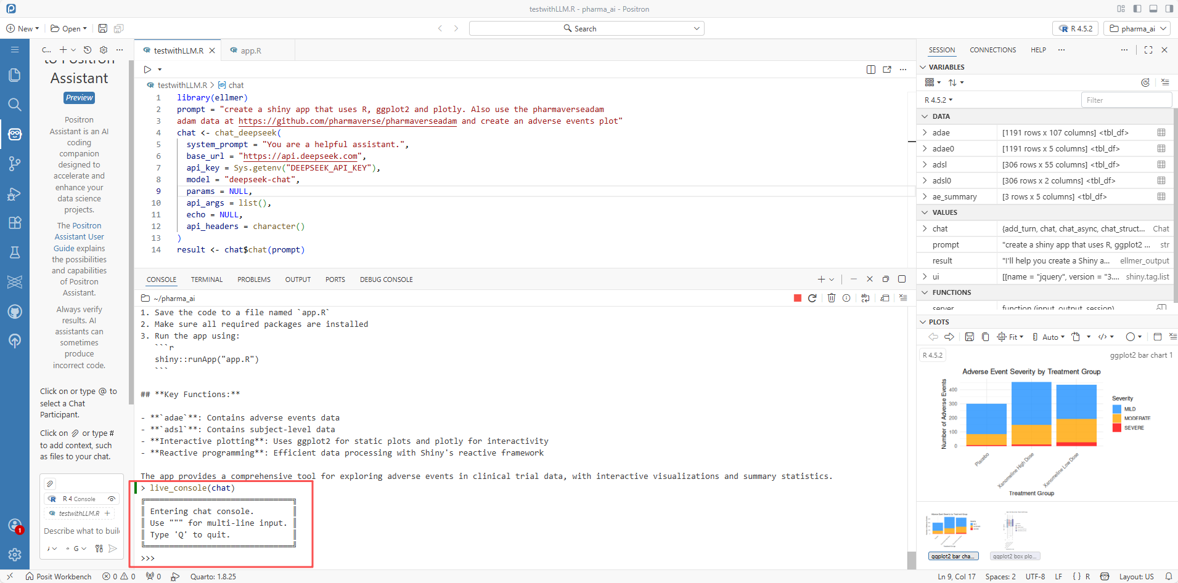
Chat Console

Slide 18


Tool Calling
Define Tool functions
Register Tool
Automatic Invocation of Tools
get_current_time<-function(tz ="UTC") {
format(Sys.time(), tz = tz,
usetz =TRUE)
}
library(ellmer)
chat <- chat_openai()
chat$register_tool(tool(
get_current_time,
description =" Obtain the time of the specified time zone "
))
#Prompt,Model define
chat$chat(
“What is the CST time"
)
#Output:The Time is
Notes:
理论说完了，我们来看实际操作。实现Tool Calling只需要三步。
第一步，定义一个普通的R函数，比如这个获取当前时间的函数。这是我们要让模型使用的具体能力。
第二步，创建一个Chat对象，并使用register_tool方法将我们的函数注册为工具，同时提供描述和参数说明，帮助模型理解如何使用它。
第三步，像平时聊天一样向模型提问，当模型判断需要调用工具时，它会自动触发我们注册的函数，并将结果整合到回答中。就是这么简单！

Slide 19
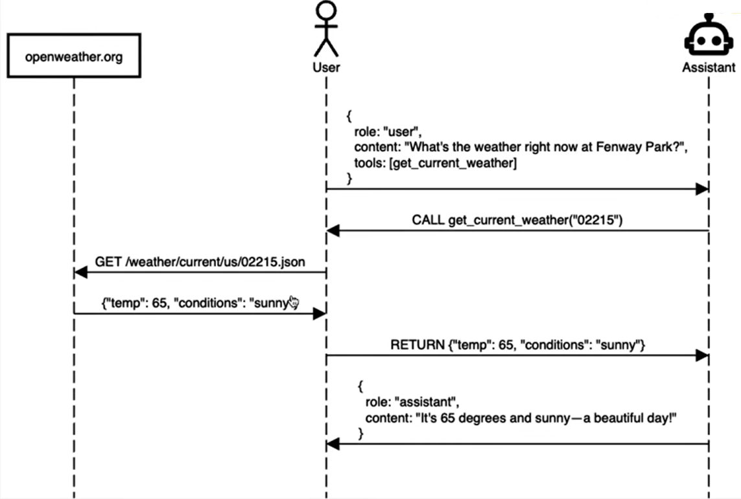
Tool Calling

Slide 20
PART
Tool Development
03
Claude and MCP tools

Slide 21

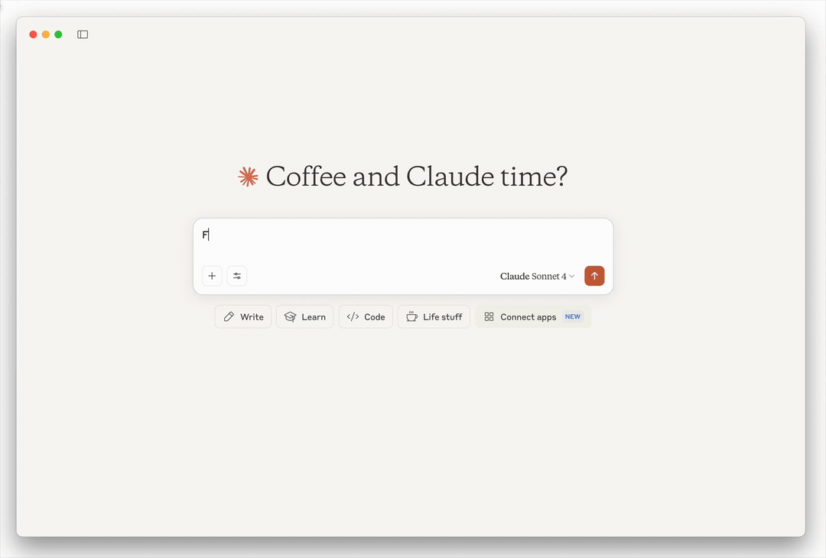


Claude and MCP
Millions Context Window
Conduct a comprehensive and thorough understanding of the entire book or large code library in one go
Constitutional AI
Constrain behavior by adhering to constitutional principles and reduce illusions
Multi-model and Tool Invocation
External API connection with the database and OCR ability
文 件

Slide 22
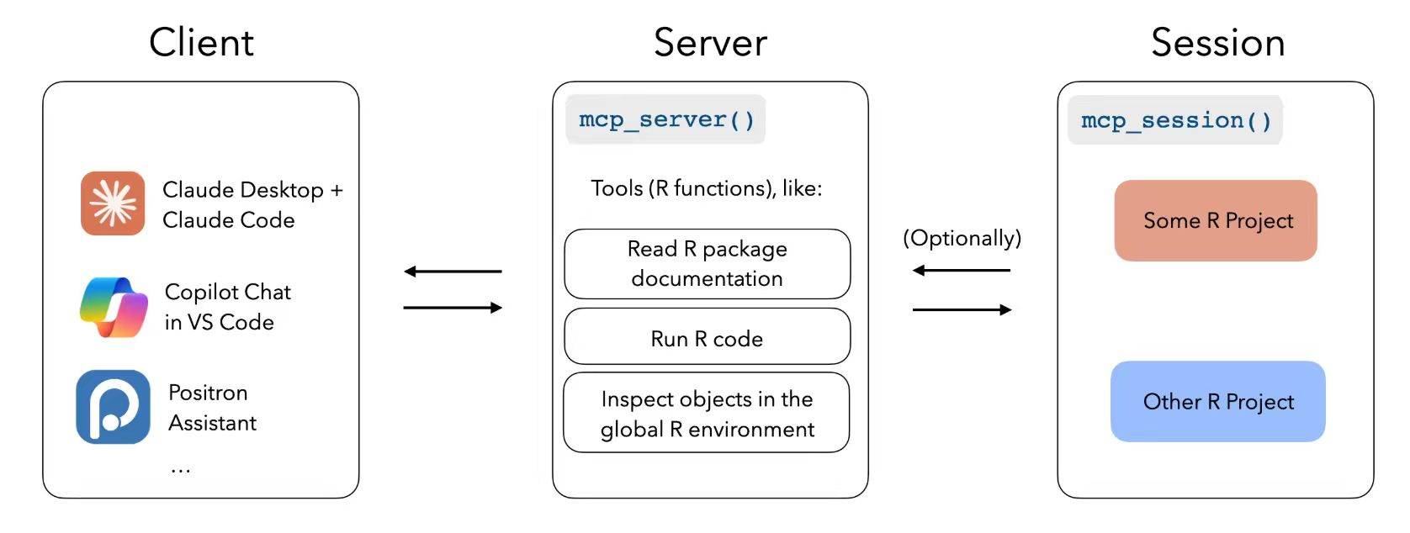
Mcptools:R as an MCP client

Slide 23
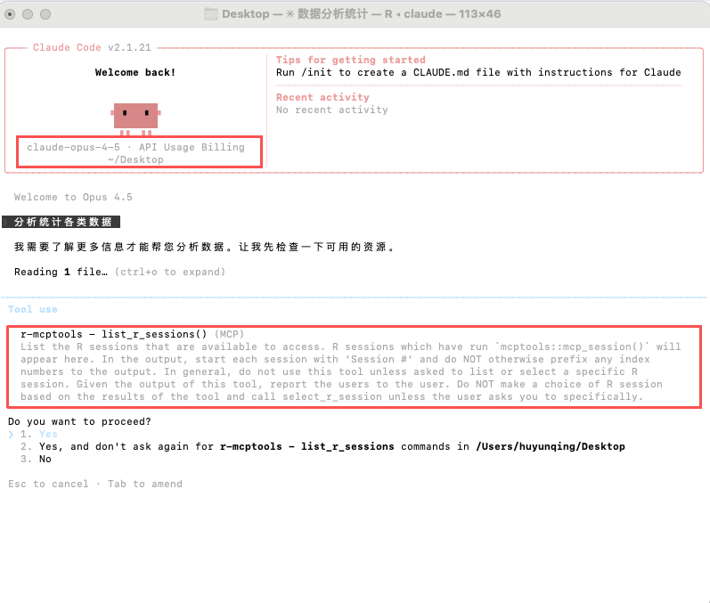
mcptools::mcp_session()

Slide 24
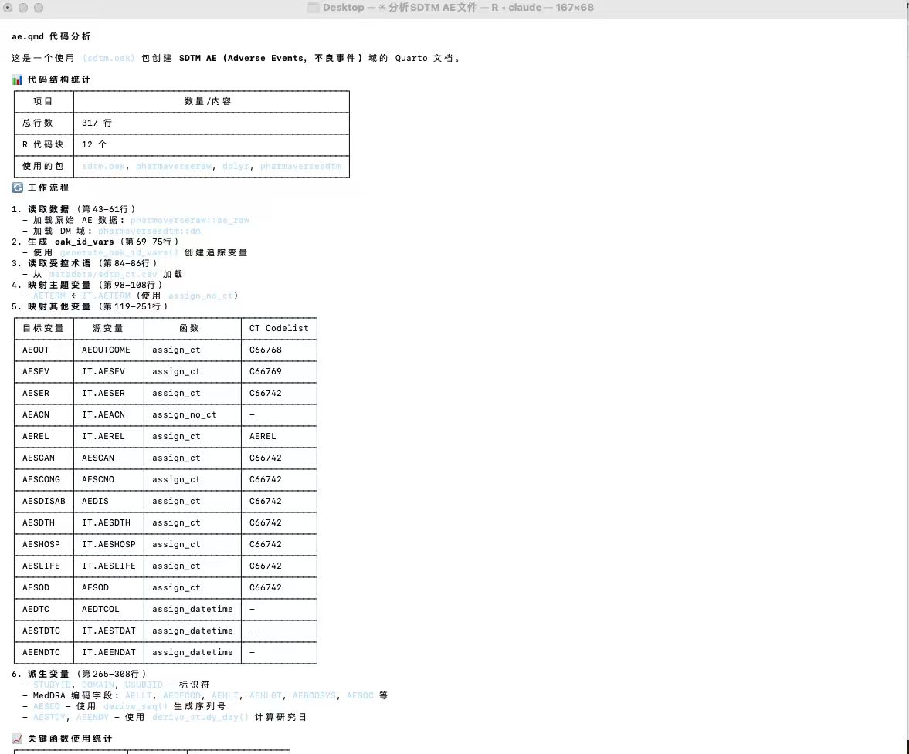
Contextual understanding
Prompt:
分析positron session里sdtm文件夹中ae.qmd

Slide 25
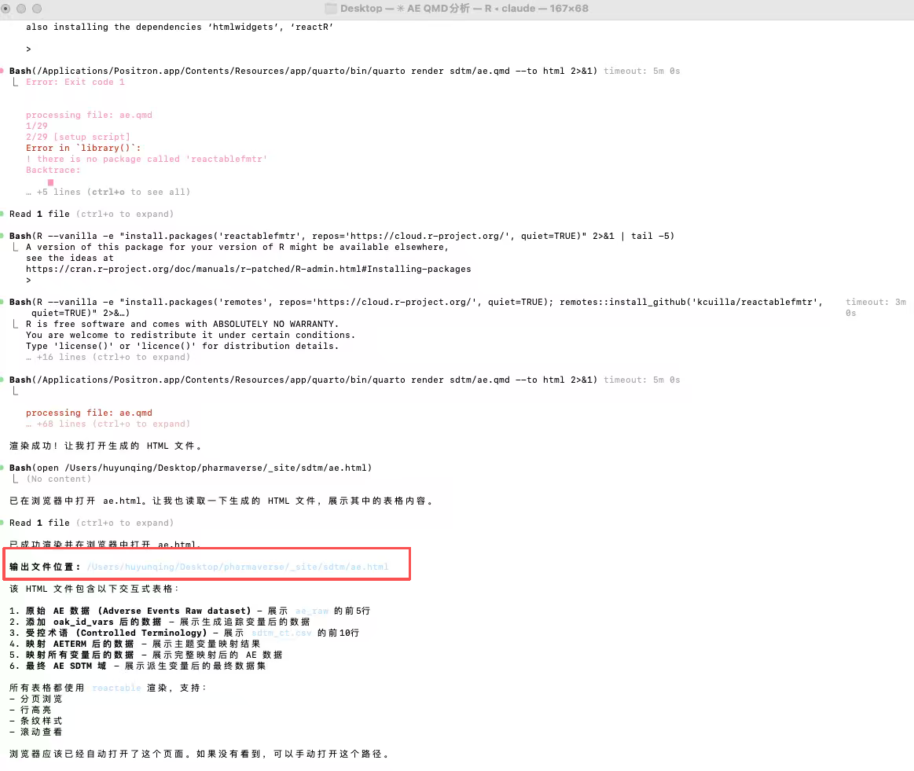
Sandbox
Execution
Prompt:
能不能帮我跑一下ae.qmd脚本，并且展示出来

Slide 26
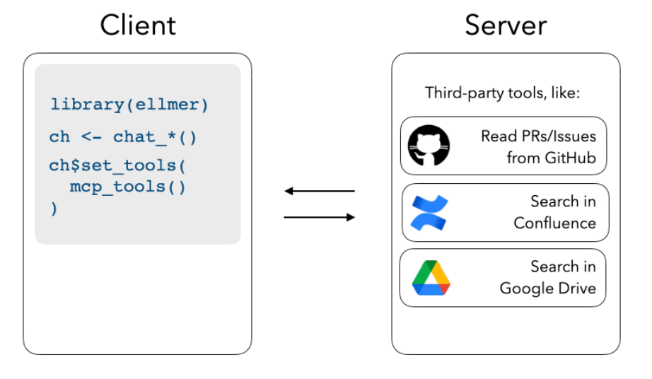
R as an MCP client

Slide 27
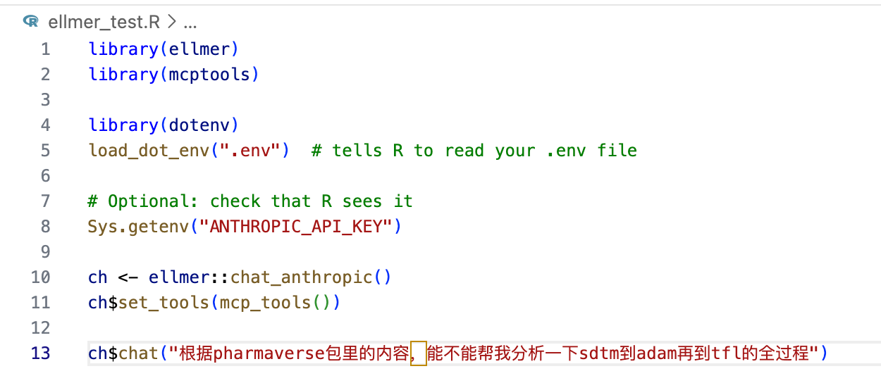
Register third-party MCP servers with ellmer chats

Slide 28
PART
Posit + Databricks
04
Databricks integration with Posit

Slide 29
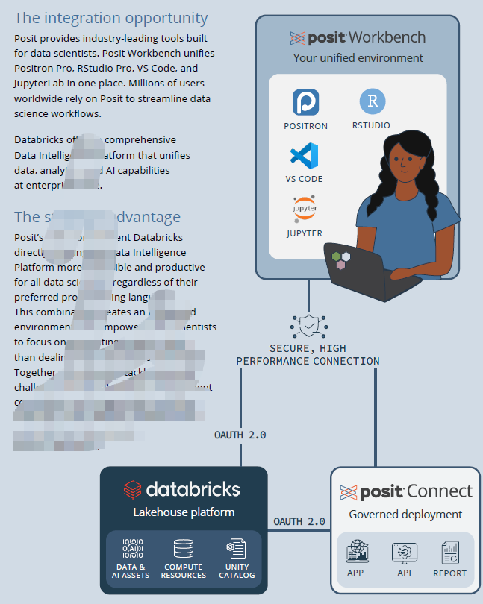
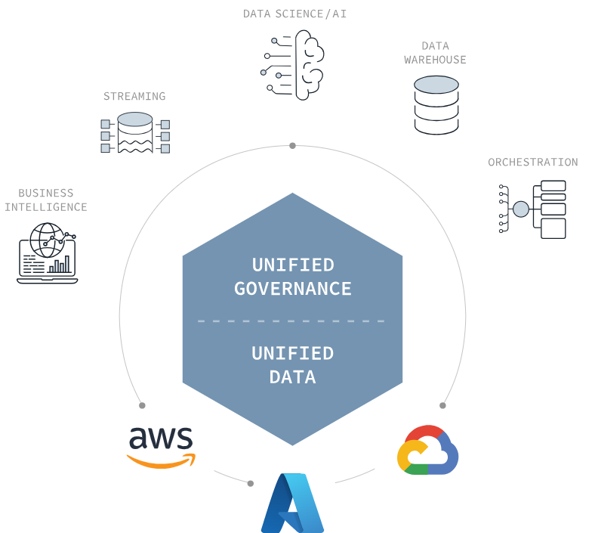
Posit + Databricks
R: library(sparklyr)

Slide 30
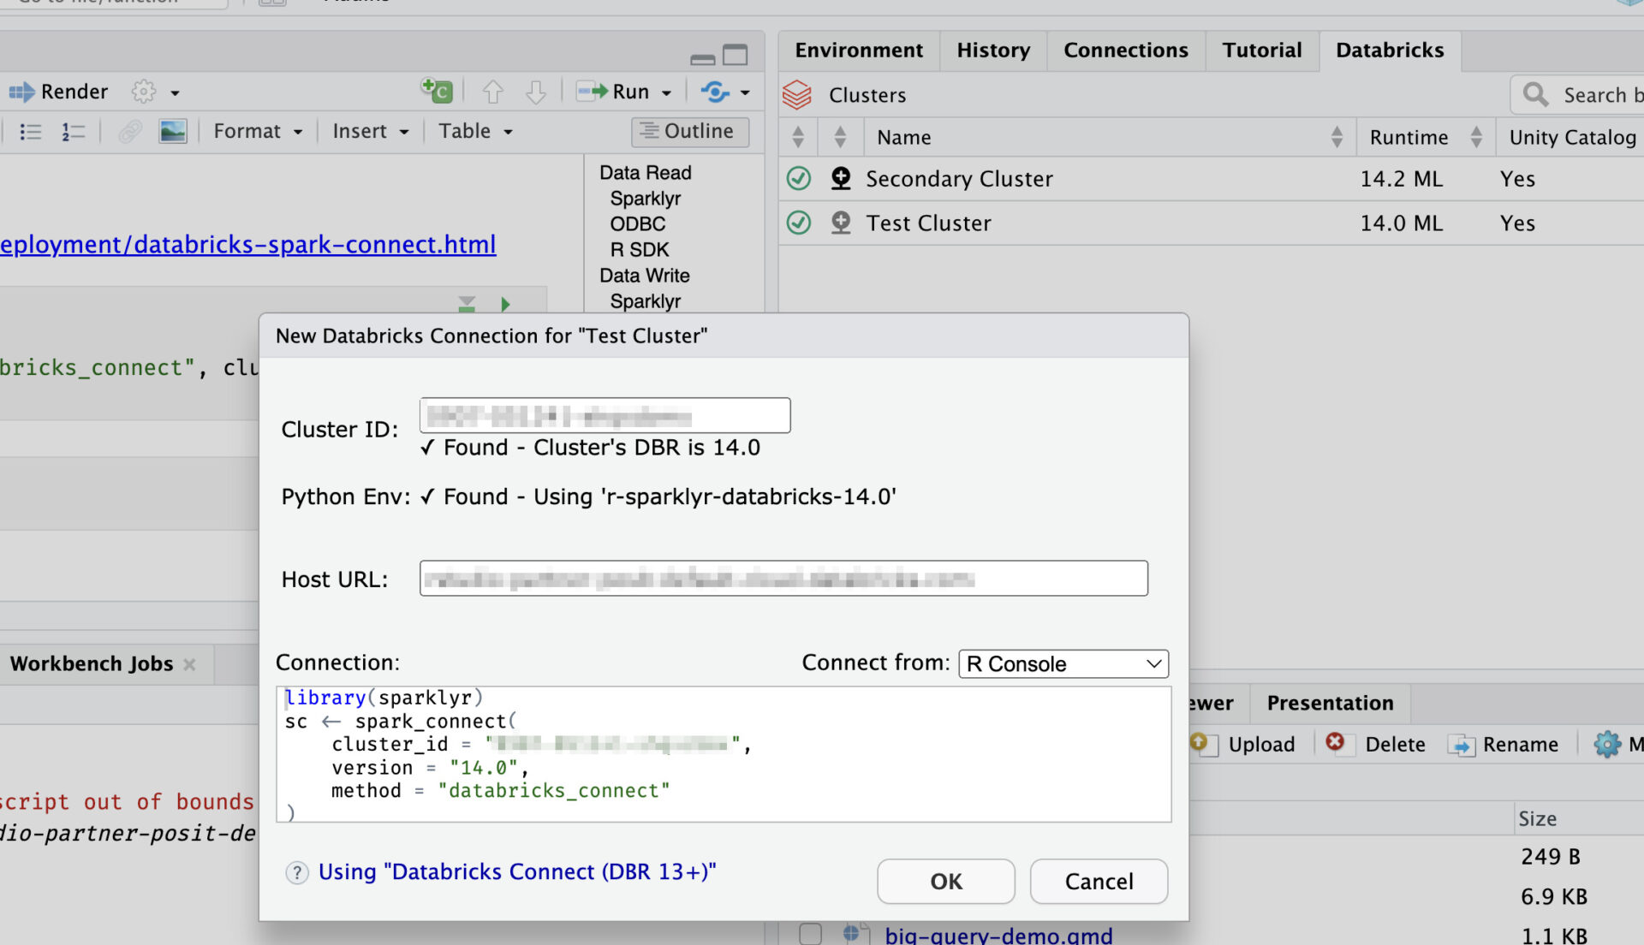
Connection to Databricks
library(sparklyr)

Slide 31
Question?

Slide 32
Thanks for your listening

